Slide 1
HoNORS SEMINAR IN ROME
May 22-June 12, 2018

Slide 2
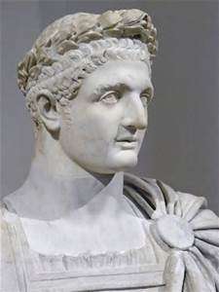
Class HONS 4900
Leadership in Italy
The program will be dedicated to ancient Rome, Renaissance in Florence and the papacy in the Vatican– connected back to modern theoretical perspectives on leadership. One week will be dedicated to each of the Leadership styles.
The ancient leadership discussions will be enhanced by field trip tours.
The modern European leadership discussions will be enhanced by internship or service days.

Slide 3
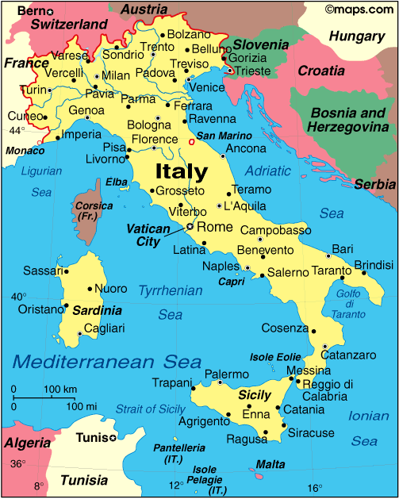
italy

Slide 4
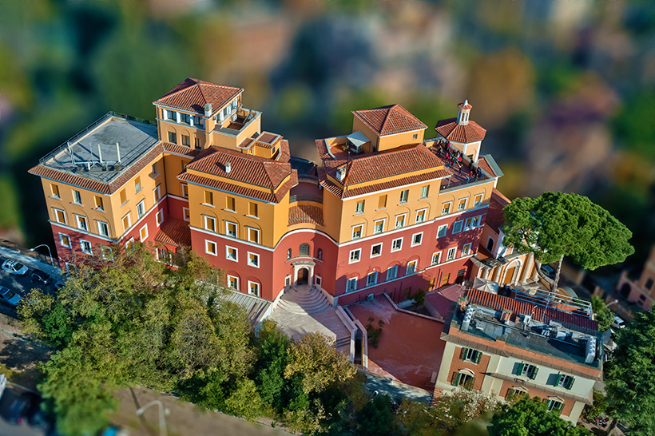
The American university of rome
The AUR campus is housed within an ancient Barnabite monastery atop the Janiculum, Rome’s highest hill

Slide 5
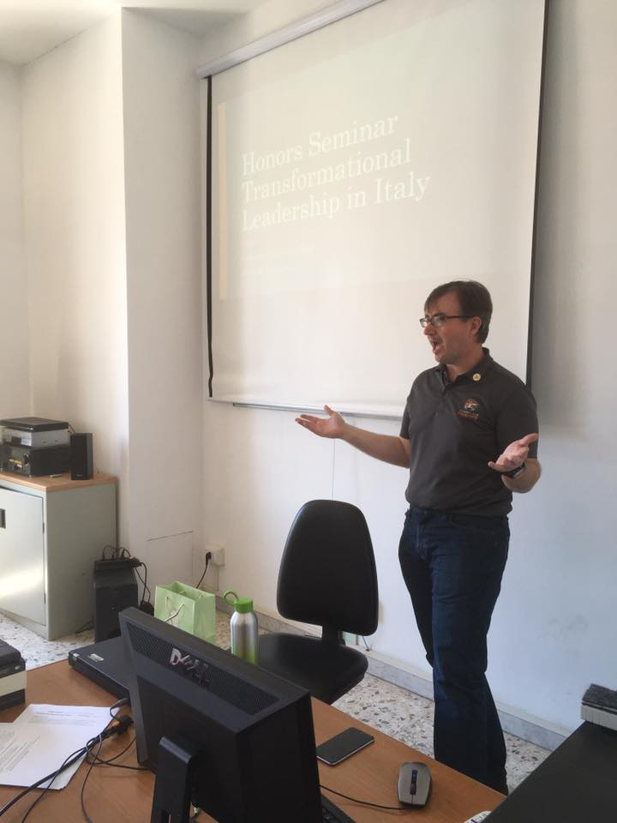
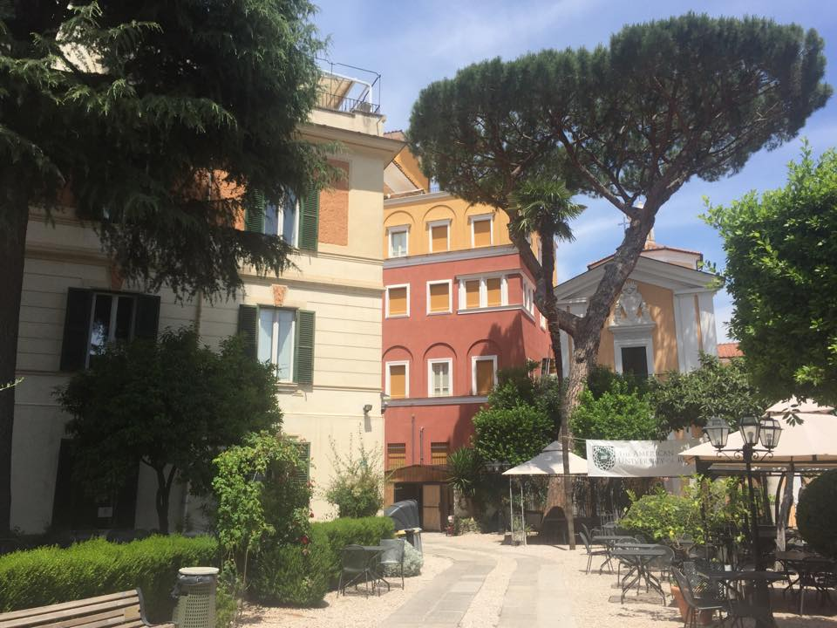
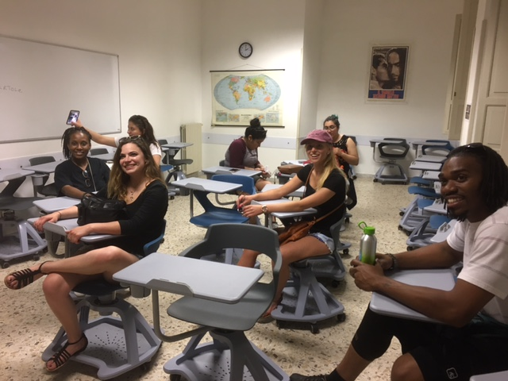
AUR CLASSROOM

Slide 6
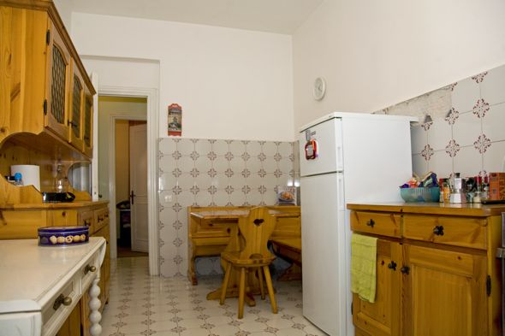
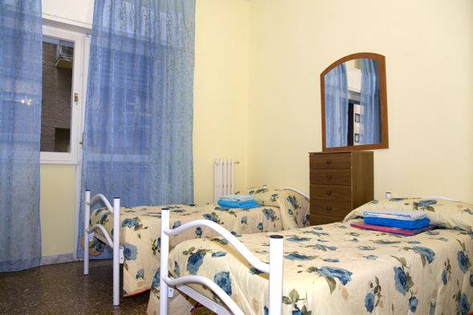
Italian apartments
Students will be housed in Italian apartments near the university
Apartments will be all male or female, complete with full kitchens and bathrooms

Slide 7
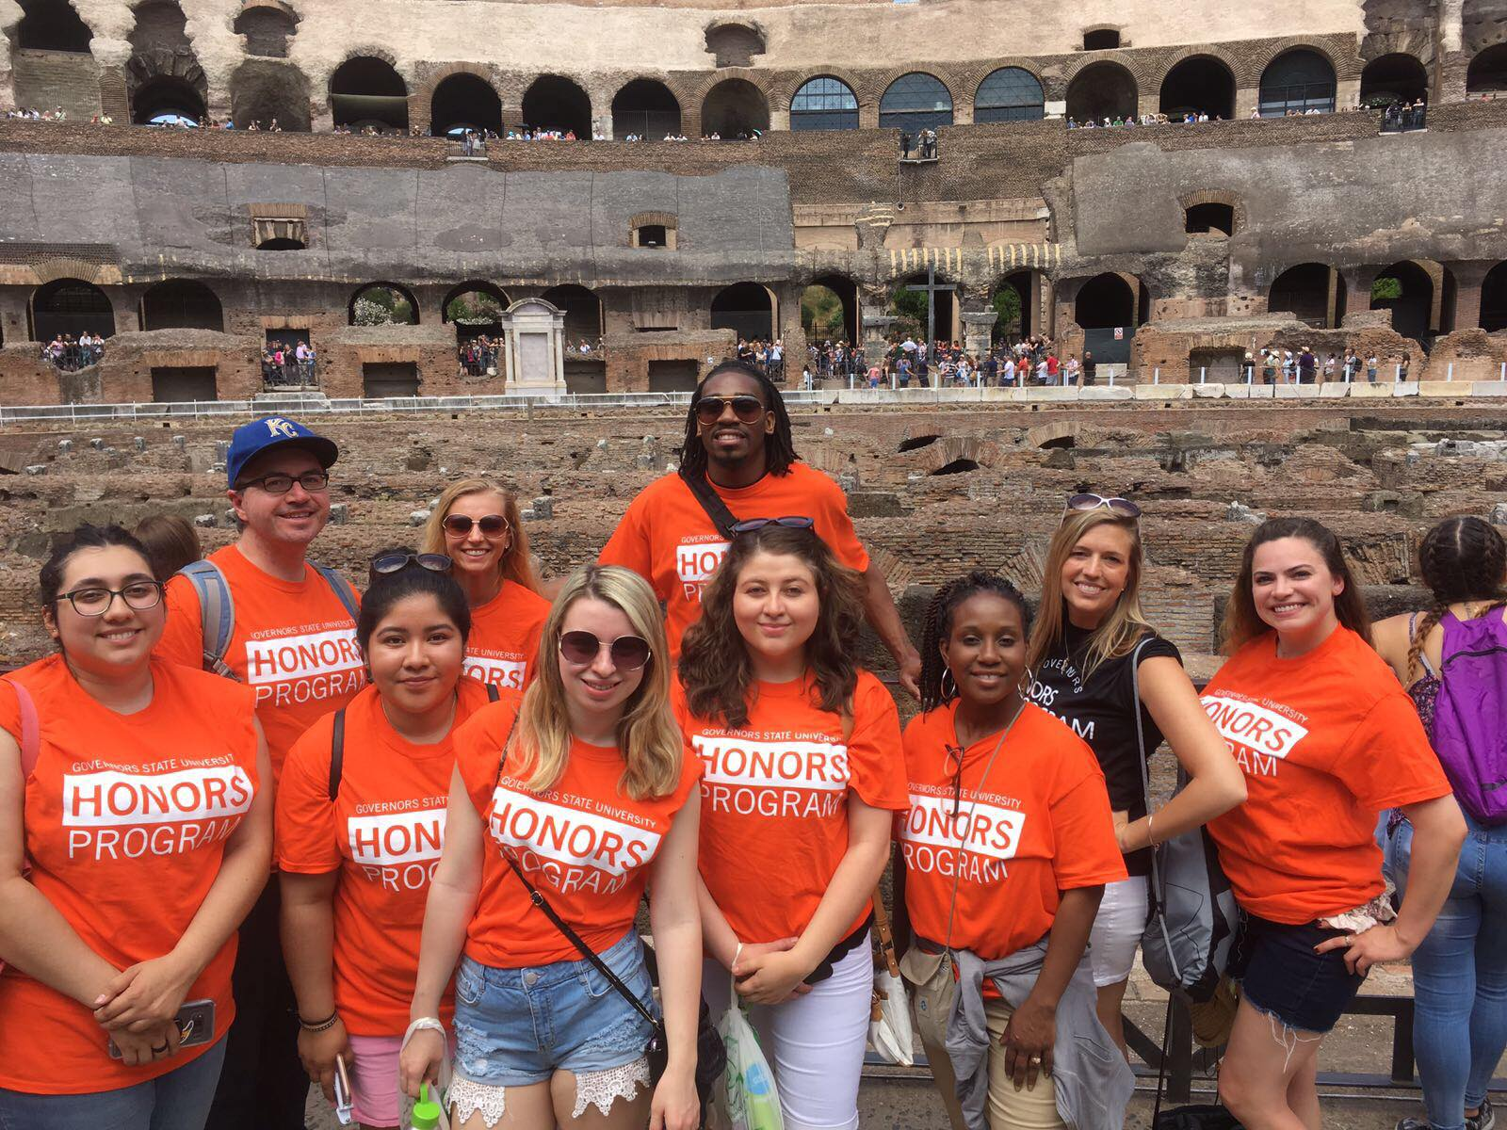
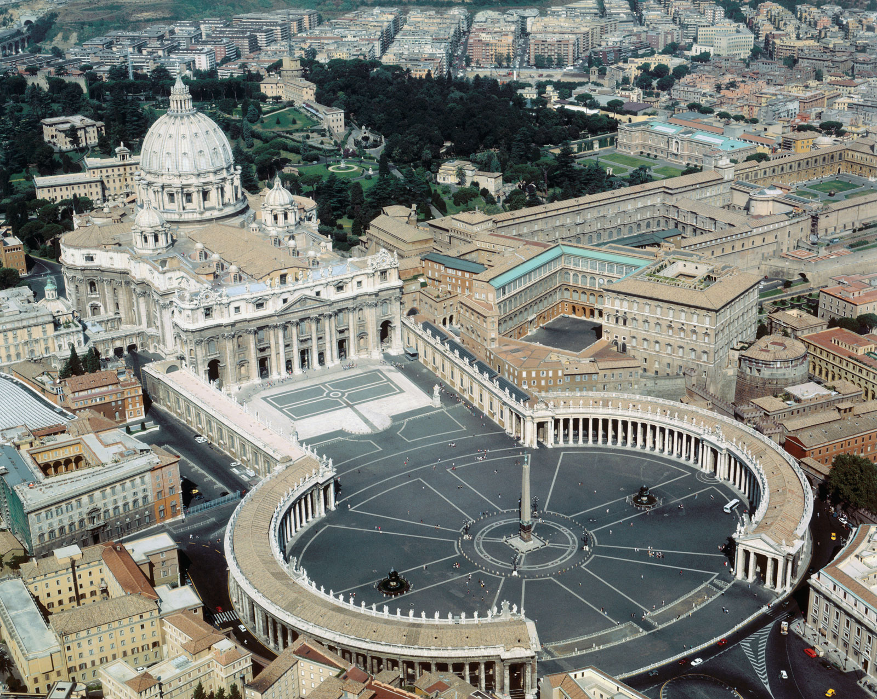
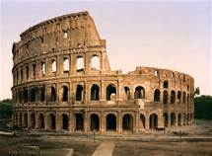
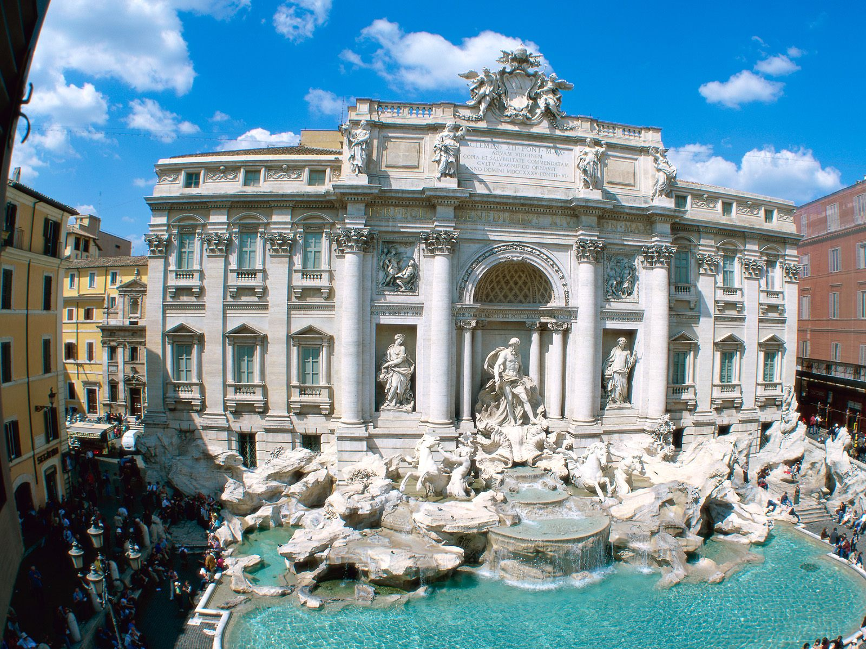
ROME And Vatican City itinerary
Arrival and Orientation to Rome
Colosseum and Roman Forum
Vatican City
Highlights of Rome
Trevi Fountain
Piazza Navona
Campo dei Fiori
Parliament

Slide 8
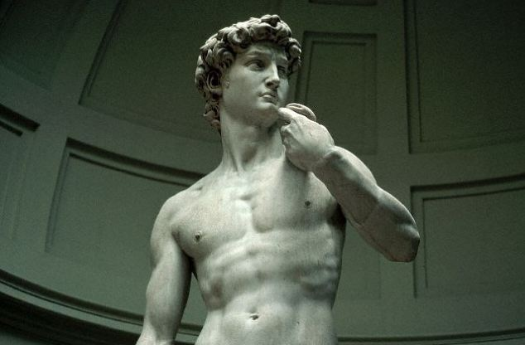
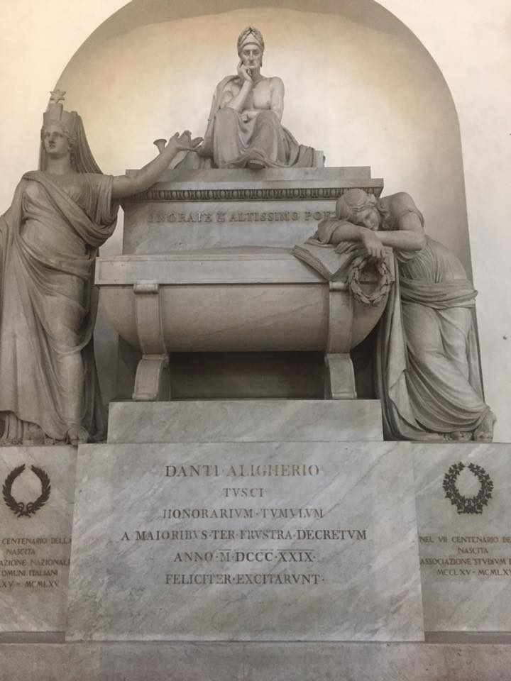
florence
Renaissance Art and Architecture
The Medici Family & City States
Diplomacy in the Renaissance

Slide 9
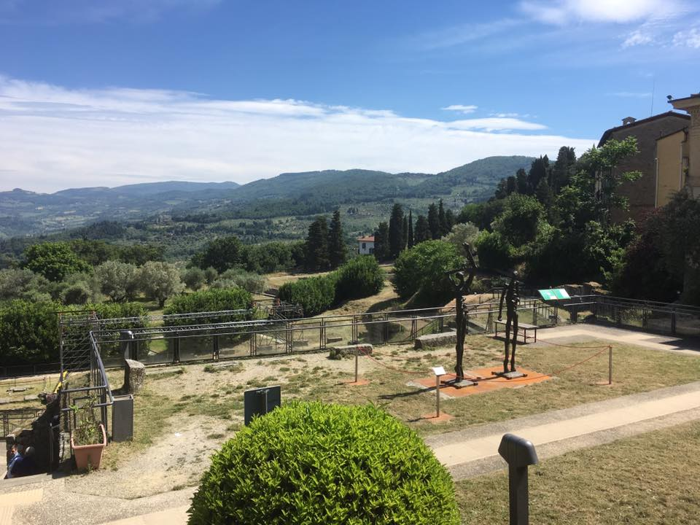
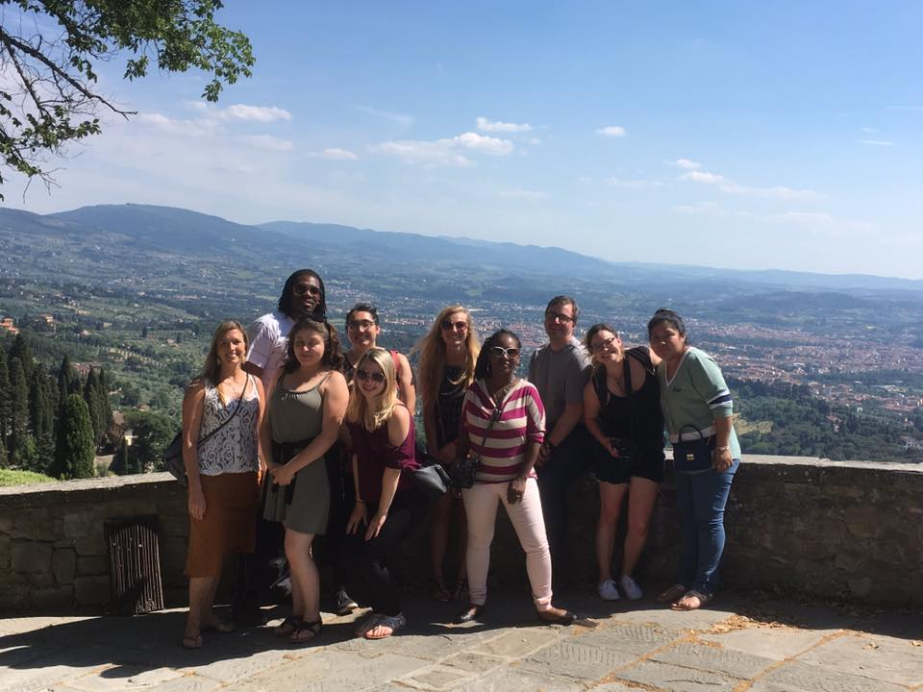
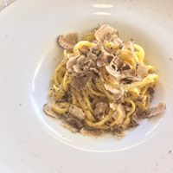
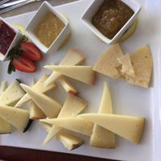
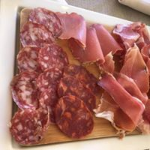
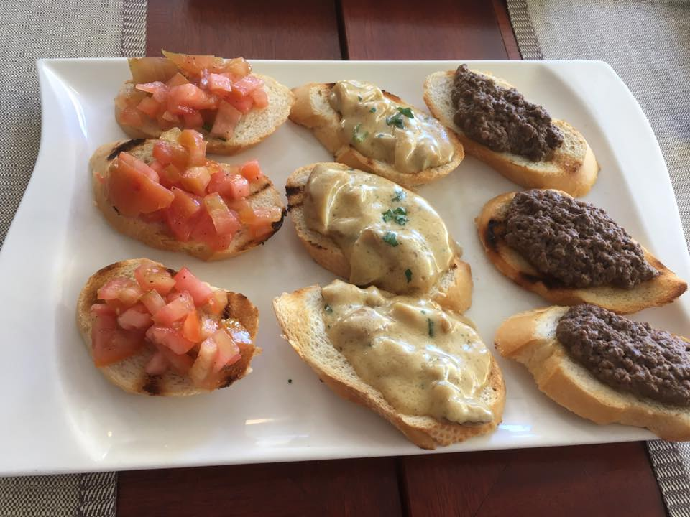
FIESOLE

Slide 10
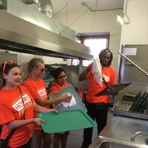
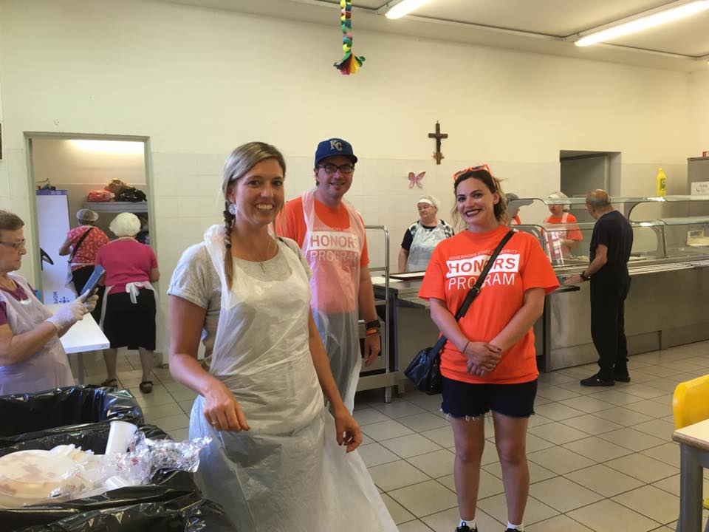
Service project
Caritas Soup Kitchen

Slide 11
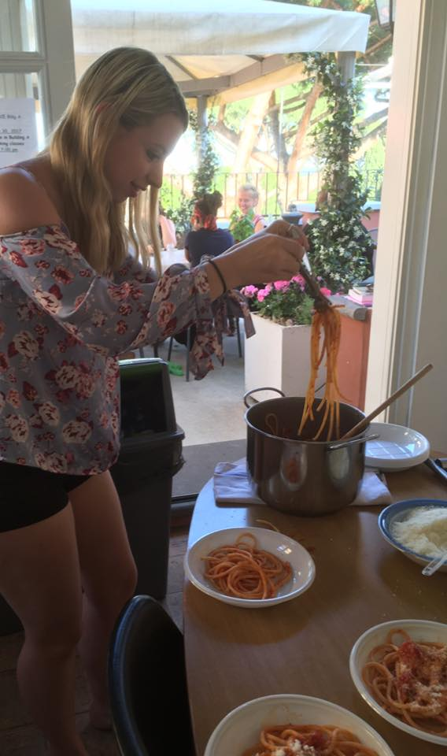
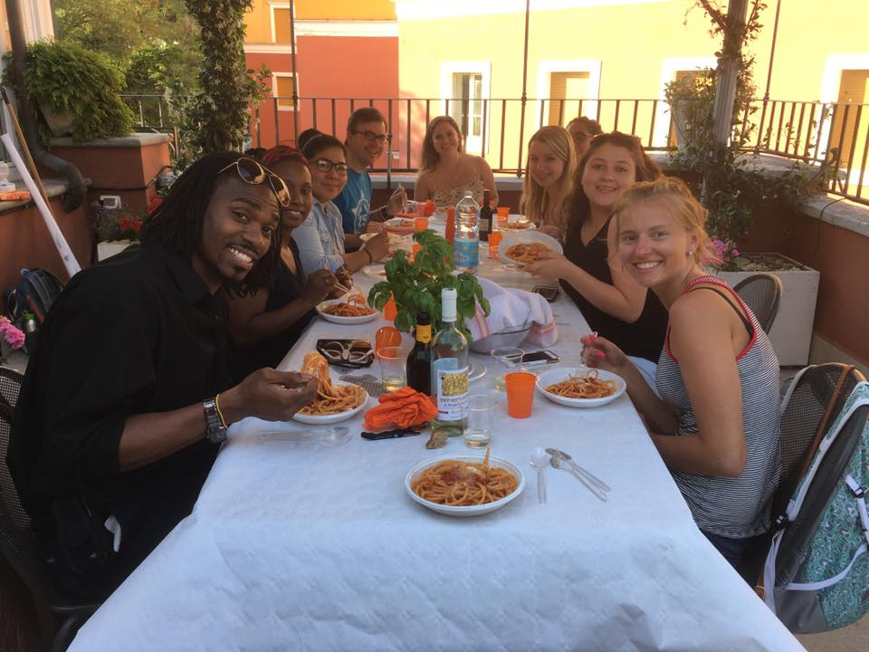
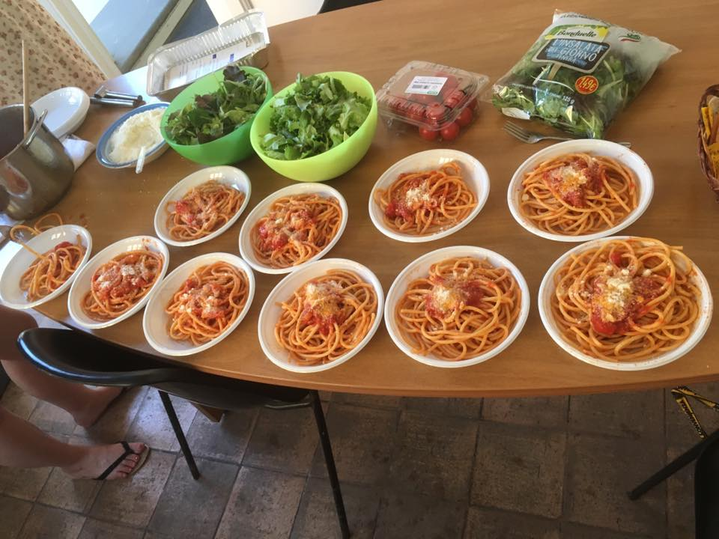
Roman Cooking lesson

Slide 12
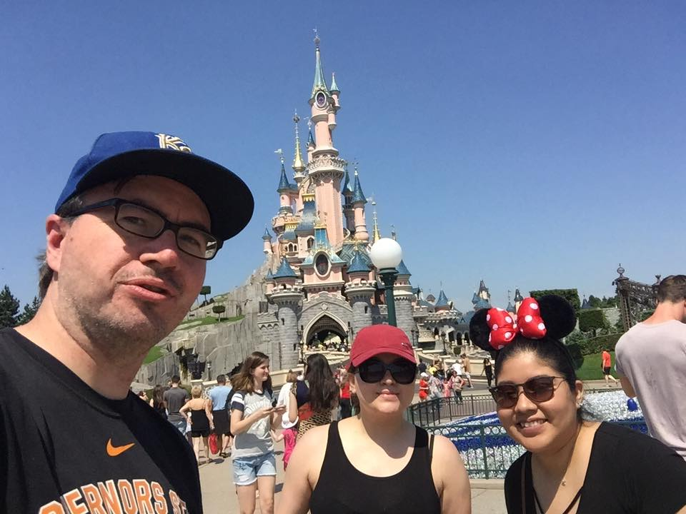
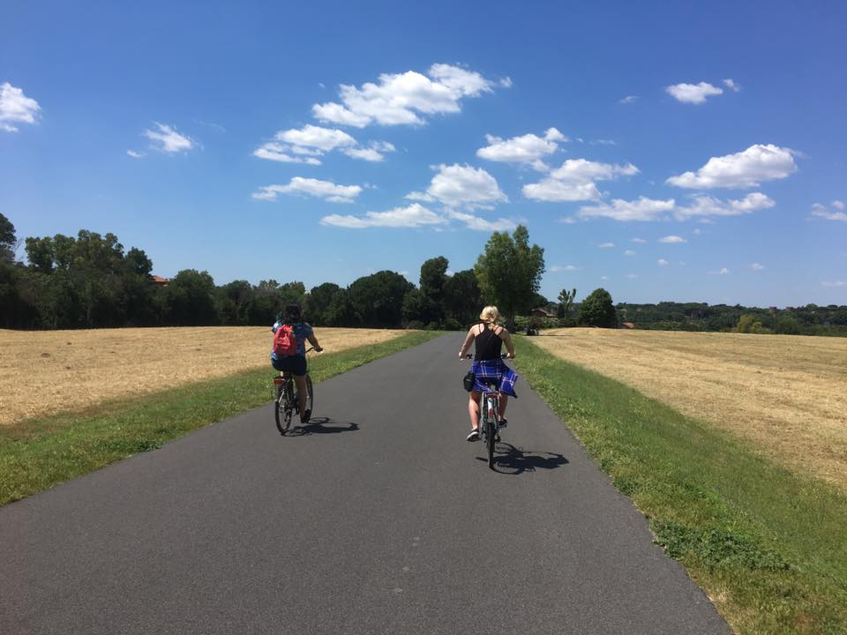
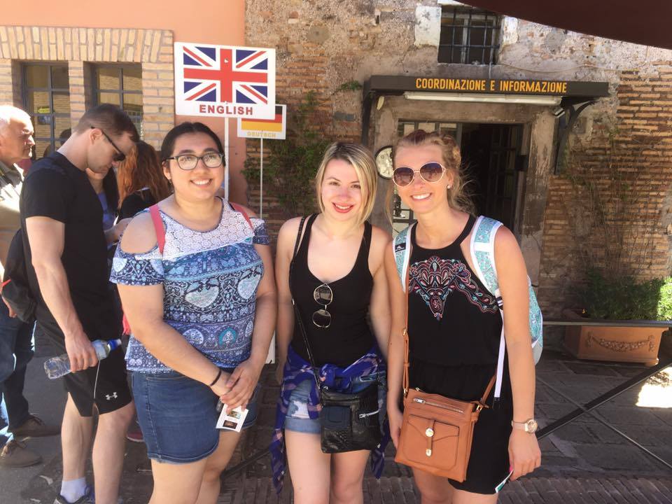
fREE WEEKENDS
Leadership Theories Lived Out

Slide 13
Program fee
$3850
Includes:
International Flight
Housing
AUR facilities (garden, classroom, computer lab)
Welcome dinner & Farewell Dinner
On-site Transportation
Hotel, train and tours in Florence
Rome Tours
Health Insurance
Does not Include
GSU Tuition
Meals ($20/day)
Personal Expenses
Deadlines
Application & Deposit: February 15
Scholarship: February 1 or March 15
First deposit: $1000
Other payments: March 15 ($1000), April 15, ($1000), May 1 ($850 or remaining balance)

Slide 14
Financial aid and scholarships
Check with financial aid to see if you are eligible for aid during the summer or if you would like to take out a loan.
Travel Grant – Deadline is March 8
100 grants of $2,000 each
Gilman Scholarship – Deadline is March 6
Federal Pell Grant Recipients
2,900 scholarships of up to $5,000 in awards
Study Abroad Scholarship – Deadline is February 1 or March 15, 2018
Application Form
500-1000 Word Essay + Follow-On Project
Resume
2 Letters of Recommendation (Academic or Professional)
$500-750

Slide 15
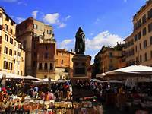
Application process
Make appointment with Study Abroad Coordinator
Amy Schoenberg aschoenberg@govst.edu
Meet with Financial Aid Advisor
Matt Zarris mzarris@govst.edu
Fill out application forms & deposit by February 15
Apply for Study Abroad Scholarship by Feb. 1 or March 15
Make first deposit of $1000 by February 15

